Slide 1
JAVA BASIC
FPT Software_Fville2_FHO.FA
Author: Le Thi Thu Ha _ HaLTT5
Version 01 – 24/02/2017

Slide 2

Hello!
I am Le Thi Thu Ha
I am here to present about Java Core.
You can find me at:
@HaLTT5

Slide 3
GUIDELINE FOR PRESENTING
1. Explain about the different forms of Polymorphism?
Overriding
Overloading
Anonymous class
3. What are differences between List and Set?
2. List all collection. Explain about the different list and linklist.
What do we should use to add 10 numbers from 0 -10?
4. Explain in short how JAVA exception handlings work?
5. Explain the wait() and notify() and notifyAll() method?
6. How to find if linked list has a loop ? Use two pointer approach to solve this problem.
- Increment 'one node' pointer before the processing 'two nodes' pointer;
-We are likely to find a situation where both the pointers will be pointing to same node. This will only happen if linked list has loop.

Slide 4
GUIDELINE FOR PRESENTING
1. Explain about the different forms of Polymorphism?
Overriding
Overloading
Anonymous class
2. List all collection. Explain about the different list and linklist.
What do we should use to add 10 numbers from 0 -10?
3. What are differences between List and Set?
4. Explain in short how JAVA exception handlings work?

Slide 5
1. Explain about the different forms of Polymorphism

Slide 6
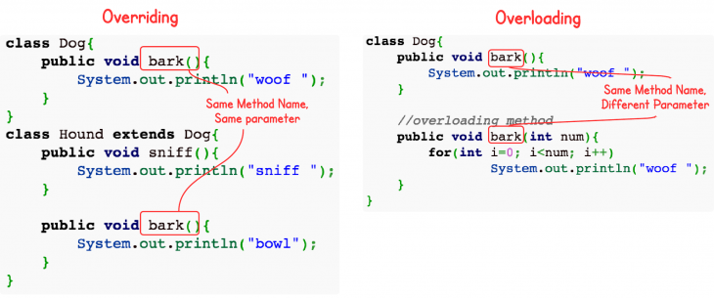
OVERRIDING – OVERLOADING – ANONYMOUS CLASS
Notes:
Nằm trong cơ chế thừa kế và đa hình, việc sử dụng lại code để đơn giản hóa công việc, code ngắn gọn hơn.
Ovr: sửa lại hàm có sẵn từ lớp cha. Giống tên, giống tham số truyền vào nếu có giống kiểu trả về. Làm việc trên nhiều class
Ovloading: giống tên, giống kiểu trả về nhưng tham số và số lượng tham số truyền vào khác nhau. Chỉ trên 1 class

Slide 7
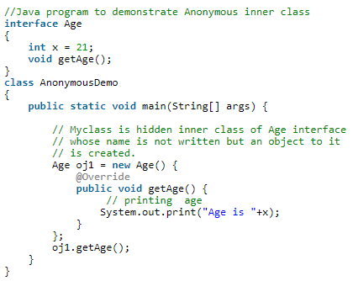
OVERRIDING – OVERLOADING – ANONYMOUS CLASS
Demo
Notes:
Class ko có tên, implement từ interface hoặc extend từ abstract class.
Những việc chỉ sử dụng 1 lần, ko cần dùng lại. Ví dụ bài chạy đua cuả pet.
Cùng 1 hành động nhưng lại ko thể định nghĩa bằng code giống các tập trước.

Slide 8
2. List all collection. List and linkedlist.

Slide 9
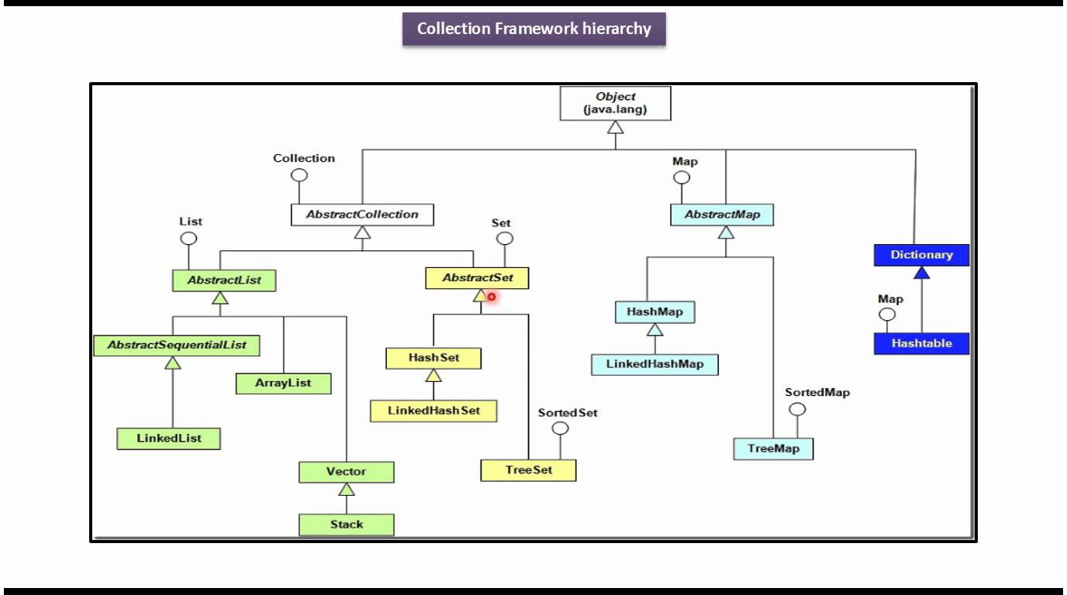
COLLECTION
2. List all collection. List and linkedlist.
Notes:
List: kích thước List chưa biết trước, duyệt bởi index, nhanh
Nhưng khi xóa thêm phần tử thì phải thay đổi size. Lâu hơn.
Linked List: duyệt 1 phần từ phải duyệt từ đầu , khi thêm xóa phần tử chỉ cần duyệt đến phần tử đó rồi thêm-xóa chứ ko cần thay đổi kích thước - > nhanh hơn.
---------------------------------
List và SET
-random access
-add duplicate
-sort duplicate

Slide 10

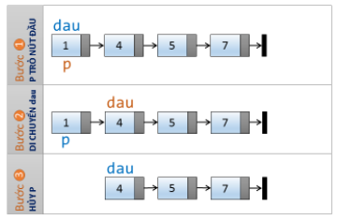
LINKED LIST
Duyệt Linked List
Xóa 1 phần tử trong Linked List

Slide 11
3. Differences between List & Set?
Demo: ListAndSet

Slide 12
4. How JAVA exception handlings work?

Slide 13
TRY-CATCH-FINALLY
try{
}catch(Exception e1) {
}catch(Exception e2) {
}catch(Exception eN) {
}finally {
}
…code
Demo: TestTryCatch

Slide 14
THOW - THROWS
Function_1() throws xxxException{
… throw xxxException(“ Exception !!!!”);
…continue code
}
Function_2(){
…
try{
…
}catch(xxxException){
handle exception
…
}
…
}
DemoThrows

Slide 15
Thanks FOR LISTENING!
Any questions?
You can find me at:
@HaLTT5
HaLTT5@fsoft.com.vn

